Slide 1
File Functions in PHP

Slide 2
Functions Used in File Handling
1) fopen(filename,mode) - used for opening a file with specific mode.
2) fclose(fp) - used to close the file. (fp -> filepointer)
3) feof(fp) - used to find the End of File
4) fgetc(fp) - Gets character from file pointer
5) fgets(fp) - Gets a line from file pointer
6) fread(fp,size) - Binary-safe file read
7) fscanf(fp,format) - Parses input from a file according to a format
8) fwrite(fp,string) - Binary-safe file write
9) file_put_contents(fp,string) - Write a string to a file
10) file_get_contents(fp)- Reads entire file into a string
11) file(fp) - Reads entire file into an array
12) file_exists(fp) - Checks whether a file or directory exists

Slide 3
Functions contd..
13) is_readable(fp) - Tells whether the filename is readable
14) is_writable(fp) - Tells whether the filename is writable
15) is_file(path) - Tells whether the filename is a regular file
16) is_dir(path) - Tells whether the filename is a directory
17) glob - Find pathnames matching a pattern
18) filesize(fp) - Gets file size
19) filetype(fp) - Gets file type
20) fprintf(fp,format) - Write a formatted string to a stream
21) fstat(fp) - Gets information about a file using an open file pointer

Slide 4
File create
The fopen function needs two important pieces of information to operate correctly.
First, we must supply it with the name of the file that we want it to open.
Secondly, we must tell the function what we plan on doing with that file (i.e. read from the file, write information, etc).
Example //fileopen.php
<?php
$ourFileName = "testFile.txt";
$ourFileHandle = fopen($ourFileName, ‘w') or die("can't open file");
fclose($ourFileHandle);
?>

Slide 5
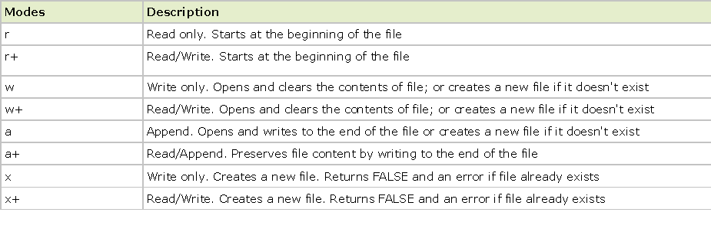
fopen
The fopen() function is used to open files in PHP.
The first parameter of this function contains the name of the file to be opened and the second parameter specifies in which mode the file should be opened.
File Modes

Slide 6
fwrite () PHP Function
fwrite() writes the contents of string to the file stream pointed to by handle.
Syntax:
  fwrite (file handle, StringData)
You need to open a file in the handling for the fwrite to work.
Example: //file2.php
<?php
//$myFile = "testFile.txt";
$fh = fopen($myFile, 'w') or die("can't open file");
$stringData = “Hello\n";
fwrite($fh, $stringData);
$stringData = “World\n";
fwrite($fh, $stringData);
fclose($fh);
?>

Slide 7
Fread Function in PHP
Syntax
  string fread ( resource $handle , int $length )
fread() reads up to length bytes from the file pointer referenced by handle. Reading stops as soon as one of the following conditions is met:
length bytes have been read
EOF (end of file) is reached --- fille2.php

Slide 8
Example
<?php
// get contents of a file into a string
//$filename = "readfile.txt";
$handle = fopen("readfile.txt”, "r");
$contents = fread($handle, filesize($filename));
print("$contents");
fclose($handle);
?>

Slide 9
File () PHP Function
The file () PHP function retrieves data from a file and puts it into an array.
The array consists of the line number, and the data held in that line starting with 0.

Slide 10
Example
<?php //fille3.php
$lines = file('YourFile.txt');
foreach ($lines as $line_num => $line)
{
echo $line . "<br />\n";
}
?>

Slide 11
Fgets()
The PHP function fgets () is used to read a file line by line
Syntax
  fgets (handle, length)
  The File must be opened in the handle. Length does not need to be included, but it will default to 1024 bytes if it is not specified.
Example //fille4.php
  <?php
  $myFile = "YourFile.txt";
  $handle = fopen($myFile, 'r');
  while (!feof($handle))
  {
  $data = fgets($handle, 512);
  echo $data;
  echo "<br>";
  }
  fclose($handle);
  ?>

Slide 12
Fgetc()
The PHP function fgetc (filehandle) is used to read a file character by character
Example: //fille4.php
<?php
$file=fopen("testfile.txt","r") or exit("Unable to open file!");
while (!feof($file))
{
echo fgetc($file);
}
fclose($file);
?>

Slide 13
Feof PHP Function
The feof () PHP Function is used to test for the end of a file
It is often used in a loop, to keep a process going until everything in the document has been processed.
Syntax
  feof($file) but more often seen as !feof($file).
Example
  <?php
  $myFile = "YourFile.txt";
  $handle = fopen($myFile, 'r');
  while (!feof($handle))
  {
  $data = fgets($handle, 512);
  echo $data;
  echo "<br>";
  }
  fclose($handle);
  ?>
  This returns the data from the file as long as feof () is not true. When it is true (you have reached the end of the file) then the loop is exited.

Slide 14
File_Get_Contents () PHP Function
File_Get_Contents () works the same as file () except it returns a string instead of an array.
This function retrieves data from an external file and then puts it into a string for use.
Example //fille6.php
<?php
$file = file_get_contents ('YourFile.txt');
echo $file;
?>

Slide 15
File_Put_Contents () PHP Function
file_put_contents — Write a string to a file
Syntax:
  int file_put_contents ( string $filename , mixed $data )
This function is identical to calling fopen(), fwrite() and fclose() successively to write data to a file.
If filename does not exist, the file is created. Otherwise, the existing file is overwritten, unless the FILE_APPEND flags is set.
Example: //file_puts_contents.php
<?php
$file = 'yourfile.txt';
// Open the file to get existing content
$current = file_get_contents($file);
echo $current;
// Append a new text to the file
$current .= "NEW CONTENT\n";
// Write the contents back to the file
file_put_contents($file, $current);
echo $current;
?>

Slide 16
file_exists
file_exists — Checks whether a file or directory exists
Syntax:
  bool file_exists ( string $filename )
Example
<?php
$filename = '/path/to/foo.txt';
if (file_exists($filename)) {
echo "The file $filename exists";
} else {
echo "The file $filename does not exist";
}
?>
is_readable() - Tells whether a file exists and is readable
is_writable() - Tells whether the filename is writable

Slide 17
Example
<?php //is_readable.php
$filename = ‘yourfile.txt';
if (is_readable($filename))
{
echo 'The file is readable';
}
else
{
echo 'The file is not readable';
}
?>

Slide 18
File uploading
move_uploaded_file(file,newloc)
Parameter | Description
file | Required. Specifies the file to be moved
newloc | Required. Specifies the new location for the file

Slide 19
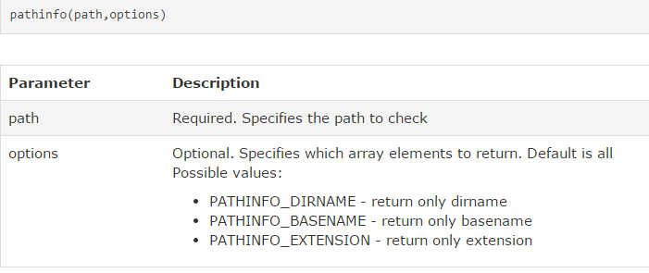
Functions used in the Program
  The pathinfo() function returns an array that contains information about a path.
  The following array elements are returned:
    [dirname]
    [basename]
    [extension]

Slide 20

File error

Slide 21
File Upload
Steps:
  Configure ‘php.ini’ file
  Create HTML form
  Create the Upload file PHP script
file_uploads = On

Slide 22
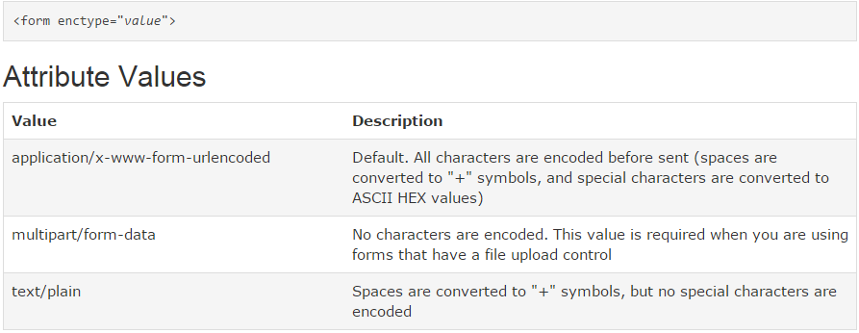
Form’s Enctype attribute
  The enctype attribute specifies how the form-data should be encoded when submitting it to the server.

Slide 25
<html>
<body>
<form action="upload2.php" method="post" enctype="multipart/form-data">
Select image to upload:
<input type="file" name="fileToUpload" id="fileToUpload">
<input type="submit" value="Upload Image" name="submit">
</form>
</body>
</html>

Slide 26
File Uploading
The enctype attribute of the <form> tag specifies which content-type to use when submitting the form. "multipart/form-data" is used when a form requires binary data, like the contents of a file, to be uploaded
The type="file" attribute of the <input> tag specifies that the input should be processed as a file. For example, when viewed in a browser, there will be a browse-button next to the input field

Slide 27
The Upload Script
By using the global PHP $_FILES array you can upload files
The files that are uploaded will be saved in $_FILES associative array.
The $_FILES array is where PHP stores all the information about files. There are two elements of this array that we will need to understand for this example.
$_FILES['uploadedfile']['name'] - name contains the original path of the user uploaded file.
$_FILES['uploadedfile']['tmp_name'] - tmp_name contains the path to the temporary file that resides on the server. The file should exist on the server in a temporary directory with a temporary name.
<?php
if ($_FILES["file"]["error"] > 0)
{
echo "Error: " . $_FILES["file"]["error"] . "<br />";
}
else
{
copy($_FILES[‘file’][‘name’],”upload/”.$_FILES[‘file’][‘tmp_name’]);
echo "Upload: " . $_FILES["file"]["name"] . "<br />";
echo "Type: " . $_FILES["file"]["type"] . "<br />";
echo "Size: " . ($_FILES["file"]["size"] / 1024) . " Kb<br />";
echo "Stored in: " . $_FILES["file"]["tmp_name"];
}
?>

Slide 28
$_FILES['userfile']['error'].
UPLOAD_ERR_OK Value: 0; There is no error, the file uploaded with success.
UPLOAD_ERR_INI_SIZE Value: 1; The uploaded file exceeds the upload_max_filesize directive in php.ini.
UPLOAD_ERR_FORM_SIZE Value: 2; The uploaded file exceeds the MAX_FILE_SIZE directive that was specified in the HTML form.
UPLOAD_ERR_PARTIAL Value: 3; The uploaded file was only partially uploaded.
UPLOAD_ERR_NO_FILE Value: 4; No file was uploaded.

Slide 29
Adding Restrictions
<?php //upload_file1.php
if ((($_FILES["file"]["type"] == "image/gif")
|| ($_FILES["file"]["type"] == "image/jpeg")
|| ($_FILES["file"]["type"] == "image/pjpeg"))
&& ($_FILES["file"]["size"]/1024 < 20))
{
if ($_FILES["file"]["error"] > 0)
{
echo "Error: " . $_FILES["file"]["error"] . "<br />";
}
else
{
echo "Upload: " . $_FILES["file"]["name"] . "<br />";
echo "Type: " . $_FILES["file"]["type"] . "<br />";
echo "Size: " . ($_FILES["file"]["size"] / 1024) . " Kb<br />";
echo "Stored in: " . $_FILES["file"]["tmp_name"];
}
}
?>

Slide 30
Counting the visitors
<?php
/*
* Program Name : file1.php
*/
$path = "counter1.txt";
$fp = fopen($path, "r");
$count = fread($fp, 512);
fclose($fp);
$count = $count + 1;
echo "<p>Page views: " . $count . "</p>";
$fp = fopen($path, "w");
fwrite($fp, $count);
fclose($fp);
?>

Slide 31
Server Side Includes (SSI)
You can insert the content of one PHP file into another PHP file before the server executes it, with the include() or require() function.
The two functions are identical in every way, except how they handle errors:
  include() generates a warning, but the script will continue execution
  require() generates a fatal error, and the script will stop

Slide 32
PHP include() Function
The include() function takes all the content in a specified file and includes it in the current file.
If an error occurs, the include() function generates a warning, but the script will continue execution.
Example: //include.php
<html>
<body>
<?php include("header.php"); ?>
<h1>Welcome to my home page!</h1>
<p>Some text.</p>
</body>
</html>

Slide 33
Adding on Multiple Pages
Prog1:
<? Php //menu.php
a href="/default.php">Home</a>
<a href="/tutorials.php">Tutorials</a>
<a href="/references.php">References</a>
<a href="/examples.php">Examples</a>
<a href="/about.php">About Us</a>
<a href="/contact.php">Contact Us</a>
?>
Prog2: //include2.php
<html>
<body>
<div class="leftmenu">
<?php include("menu.php"); ?>
</div>
<h1>Welcome to my home page.</h1>
<p>Some text.</p>
</body>
</html>

Slide 34
PHP require() Function
The require() function is identical to include(), except that it handles errors differently.
If an error occurs, the include() function generates a warning, but the script will continue execution. The require() generates a fatal error, and the script will stop.
Example:
<html>
<body>
<?php
require("wrongFile.php");
echo "Hello World!";
?>
</body>
</html>

Slide 35
Reference
http://www.tizag.com/phpT/files.php
http://php.about.com/od/programingglossary/g/file_php.htm
http://www.w3schools.com/php/php_includes.asp
http://in2.php.net/manual/en/function.file-put-contents.php

